Slide 1

Title: Columbia Asia Hospital project.
Name: Lokesh sharma

Slide 2

Content Overview
Introduction
Objectives with Problem Statement
Data Overview
Methodology
Analysis & Key finding
Strategic Recommendations
Conclusion

Slide 3
Introduction
Columbia Asia Hospital is focused on providing high-quality healthcare while ensuring its operations run efficiently. In this project, I’ve explored hospital data to gain insights into revenue trends, patient satisfaction levels, and how different departments are performing. The goal is to understand the key metrics that drive success and suggest practical improvements to boost patient experience and enhance the hospital’s overall effectiveness.
Key Focus Areas:
Evaluated the hospital’s revenue sources to pinpoint departments generating the highest income.
Analyzed patient satisfaction scores, breaking them down by demographics and department to uncover key trends.
Identified high-traffic departments that may require additional staffing to meet patient demand effectively.
Proposed targeted discount strategies aimed at boosting patient satisfaction and encouraging long-term loyalty.

Slide 4
Objectives
Analyze the hospital’s revenue streams to determine which departments contribute the most to overall income.
Evaluate patient satisfaction scores across different demographics and departments to uncover the main factors influencing patient experience.
Assess department-wise patient demand to highlight areas where staffing improvements may be needed.
Develop practical strategies and recommendations for offering targeted discounts and enhancing patient engagement.

Slide 5

Columbia Asia Hospital is dedicated to improving its operations while prioritizing patient satisfaction. This project aims to deliver a thorough analysis to identify the departments that drive the most revenue, understand the makeup of the hospital’s patient population, and evaluate satisfaction levels across different age groups and ethnic backgrounds. It also involves assessing patient wait times, identifying eligibility for discounts, and analyzing department-wise demand — all to help develop targeted strategies that boost patient engagement and make hospital services more efficient.

Slide 6

Data Overview
Data Source: The dataset comprises detailed records from Columbia Asia Hospital, covering patient visits, doctor referrals, and billing information. Key tables like doctor_info and hospital_er provide insights into patient demographics, consultation fees, satisfaction scores, and wait times—offering a comprehensive view of hospital operations and the overall patient experience.
Tools Used:
SQL – Used for querying and extracting relevant data from the database.
Power BI – Employed to visualize the data and uncover actionable insights.

Slide 7
Methodology
Step 1: Data Extraction & Preprocessing
Used Excel and SQL to extract, clean, and prepare the data for analysis. This involved aggregating key metrics related to patient demographics, billing details, department referrals, and satisfaction scores to ensure a solid foundation for meaningful insights.
Step 2: Patient & Department Analysis
Conducted an in-depth analysis of patient satisfaction across various demographics such as age, race, and department. Assessed departmental performance by examining revenue generation, patient volume, and average wait times to identify areas of strength and opportunities for improvement.
Step 3: Financial & Operational Insights
Analyzed revenue contributions across departments to highlight top-performing areas and identify those with high patient demand that may require additional staffing. Explored the relationship between wait times and satisfaction scores to uncover key factors influencing the patient experience.
Step 4: Recommendations Offered targeted recommendations for discounts and staffing adjustments aimed at boosting patient satisfaction and enhancing operational efficiency. Proposed patient engagement initiatives, guided by satisfaction score insights, to build stronger patient relationships and encourage long-term loyalty.

Slide 8
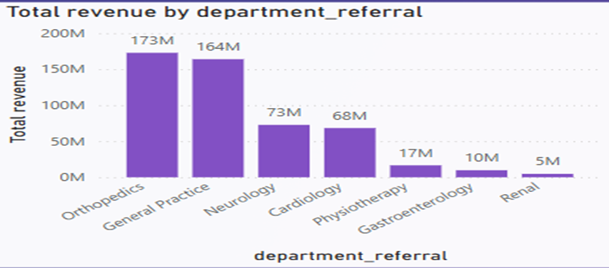
Analysis & Key finding
Revenue by Department
Objective: To identify the departments that contribute most significantly to the hospital’s overall revenue.
Analysis: The analysis revealed that Orthopedics and General Practice are the top revenue-generating departments. These areas represent core financial strengths within the hospital’s service portfolio.
Insights: Given their strong revenue performance, these departments present valuable opportunities for strategic investment. Enhancing services, expanding capacity, or increasing resource allocation in these areas could drive further growth and attract more patients.

Slide 9
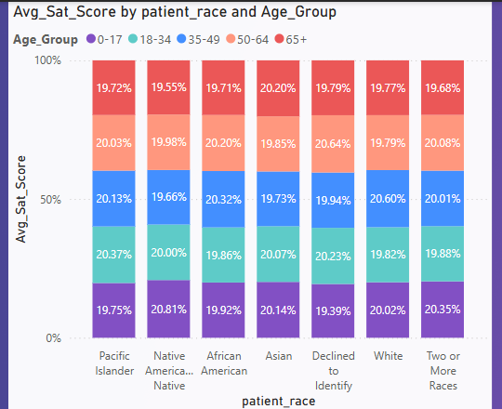
Analysis & Key finding
Patient Satisfaction Across Demographics
Objective: To evaluate patient satisfaction scores across different age groups and racial demographics, aiming to identify variations in patient experiences.
Analysis: The data showed noticeable differences in satisfaction levels among certain age and racial groups, indicating that patient experiences vary significantly based on demographic factors.
Insights: Focusing improvement efforts on demographics with lower satisfaction can help address specific needs, enhance overall patient experience, and build stronger trust and loyalty among diverse patient populations.

Slide 10
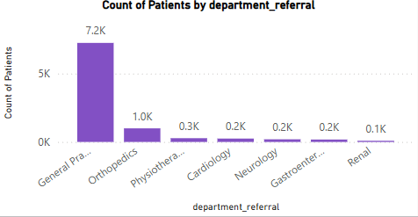
Analysis & Key finding
Departmental Patient Volume
Objective: To assess patient volume across departments and identify high-demand areas that may need additional support.
Analysis: General Practice and Orthopedics recorded the highest patient volumes, underscoring their central role in daily hospital operations and patient care.
Insights: Investing in staffing and resources for these high-traffic departments can help manage patient load more effectively, reduce wait times, and enhance overall service delivery.

Slide 11
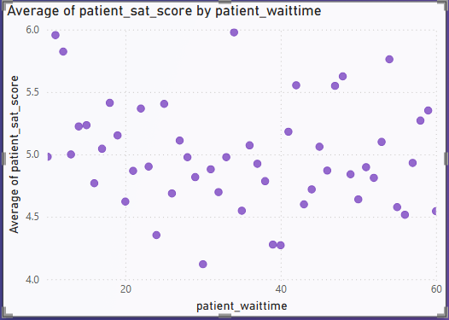
Analysis & Key finding
Wait Time Impact on Satisfaction
Objective: To evaluate how patient wait times influence satisfaction levels and assess the role of operational efficiency in shaping patient experience.
Analysis: The analysis revealed a clear negative correlation between wait times and satisfaction scores—patients who waited longer tended to report lower levels of satisfaction.
Insights: Reducing wait times, particularly in high-demand departments, can lead to meaningful improvements in patient satisfaction. Implementing smarter scheduling systems or queue management solutions during peak hours could help streamline patient flow and enhance overall efficiency.

Slide 12
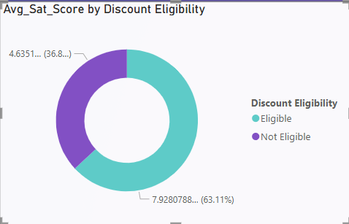
Analysis & Key finding
Discount Distribution and Eligibility
Objective: To examine how different discount levels impact patient satisfaction and evaluate the effectiveness of discounts as a tool for enhancing patient experience.
Analysis: The data showed that patients who received discounts tended to report higher satisfaction scores, suggesting that financial relief plays a role in improving overall experience.
Insights: Introducing well-targeted discount programs for eligible and cost-sensitive patients can help boost satisfaction and encourage patient loyalty. These strategies may be especially effective in improving perception among financially constrained patient groups.

Slide 13
Strategic Recommendations
Enhance High-Demand Department Efficiency
Insight: Departments such as General Practice and Orthopedics experience high patient volumes, which can lead to operational bottlenecks and longer wait times—both of which negatively affect patient satisfaction.
Recommendation:
Increase Staffing: Allocate additional medical and support staff to these high-demand departments to better manage patient flow and reduce service delays.
Optimize Scheduling: Implement efficient appointment scheduling and queue management systems to minimize wait times and improve the overall patient experience.

Slide 14
Strategic Recommendations
2. Tailored Patient Satisfaction Initiatives
Insight: Satisfaction levels differ notably across age groups and racial demographics, with certain segments consistently reporting lower satisfaction—highlighting the need for a more inclusive approach to patient care.
Recommendation:
Targeted Engagement: Design patient engagement strategies specifically tailored to demographics with lower satisfaction scores, addressing their unique concerns and expectations.
Personalized Experience: Adapt services, communication styles, and care approaches to align with the cultural and generational needs of diverse patient groups, fostering a more personalized and positive experience.

Slide 15
Strategic Recommendations
3. Optimize Discount Strategy for Improved Patient Retention
Insight: Patients who received medium to high-level discounts reported higher satisfaction levels, suggesting that financial incentives play a key role in enhancing the overall patient experience.
Recommendation:
Broaden Discount Eligibility: Extend discount offerings to include more patients, particularly those facing significant out-of-pocket expenses, to ease financial burdens and improve satisfaction.
Introduce Loyalty Programs: Implement loyalty-based discounts or incentives for follow-up visits to encourage repeat care and foster long-term patient relationships.

Slide 16
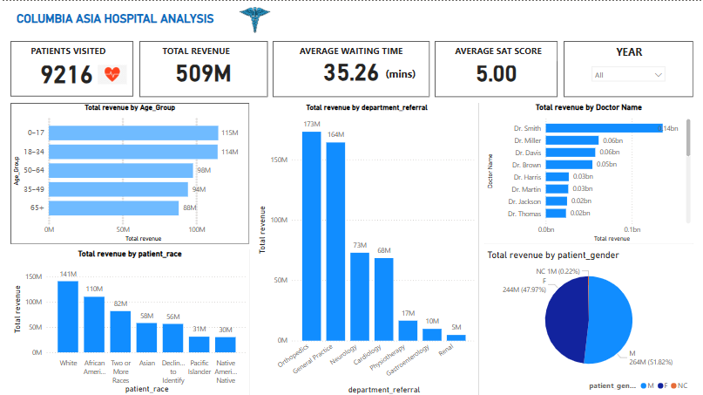
Final Dashboard (Main Tab)

Slide 17
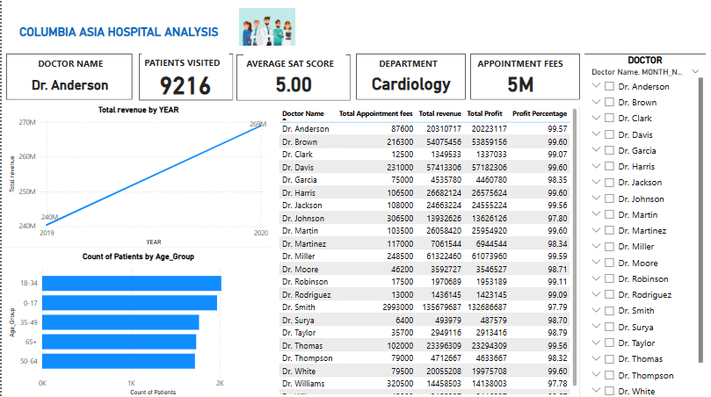
Final Dashboard (Doctor’s Tab)

Slide 18
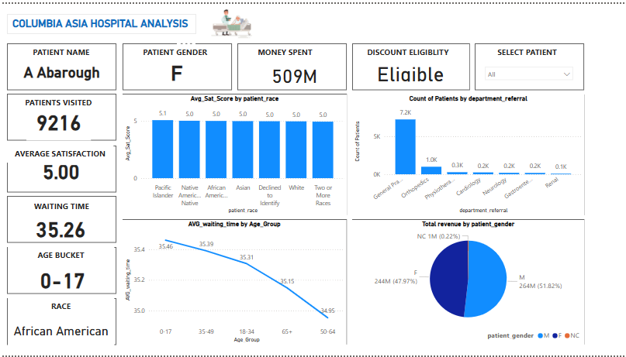
Final Dashboard (patients Tab)

Slide 19
Conclusion
By enhancing the efficiency of high-demand departments and implementing tailored patient satisfaction initiatives, Columbia Asia Hospital can effectively tackle operational challenges that impact both patient experience and revenue generation.
Introducing targeted discount strategies will play a crucial role in improving retention, particularly among cost-sensitive patient groups, fostering greater loyalty and long-term engagement.
Strategic investments in staffing, personalized care delivery, and financial support programs will position the hospital to elevate patient care, increase satisfaction scores, and drive sustainable revenue growth.
With consistent execution, these initiatives will not only optimize operational performance but also solidify Columbia Asia Hospital’s standing as a trusted and preferred healthcare provider.

Slide 20


